Slide 1
On-Premise Server Migration to Azure - Setup -
AD Setup (only Azure)

Slide 2
Configuration Steps
Steps | Process
Create VM in Azure | Script/Portal
Attach Static IP to VM | Script/Portal
Install ADDS Role | Script/Portal
Promote Azure VM as Domain Controller | Script/Portal

Slide 3
Step1: Create VM in Azure

Slide 4
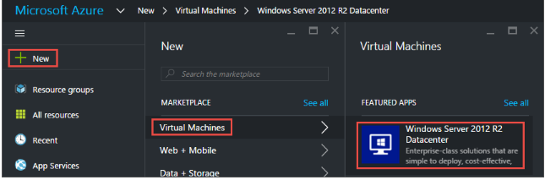
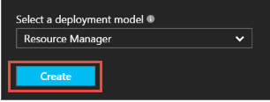
Step1: Create VM in Azure

Slide 5
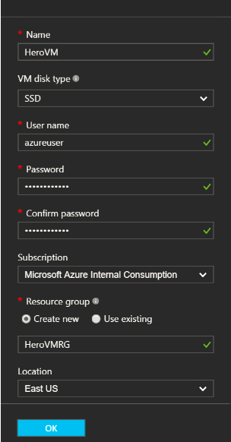
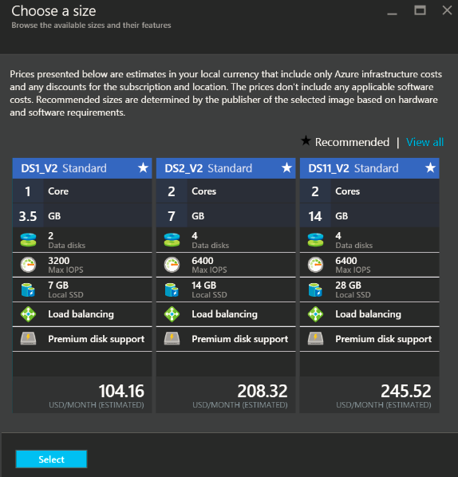
Step1: Create VM in Azure

Slide 6
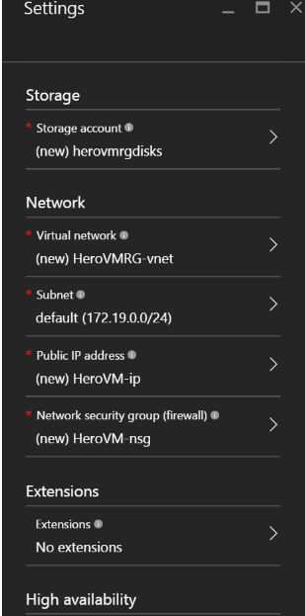
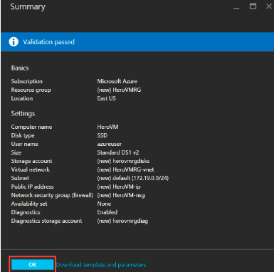
Step1: Create VM in Azure

Slide 7
Step-2: Attach Static IP to VM

Slide 8
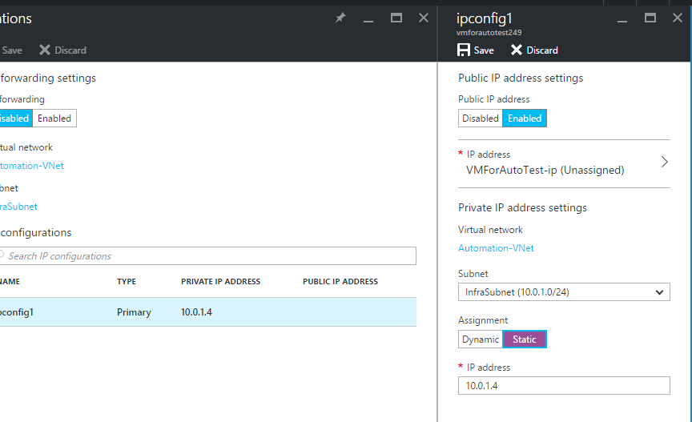
Step-2: Attach Static IP to VM
Open Network Interface settings of VM to change Private IP of VM

Slide 9
Step-3: Install ADDS Role

Slide 10
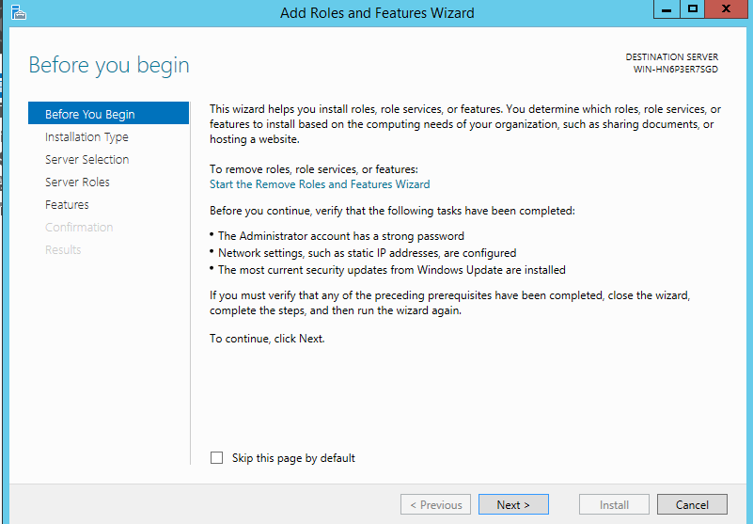
Step-3: Install ADDS Role

Slide 11
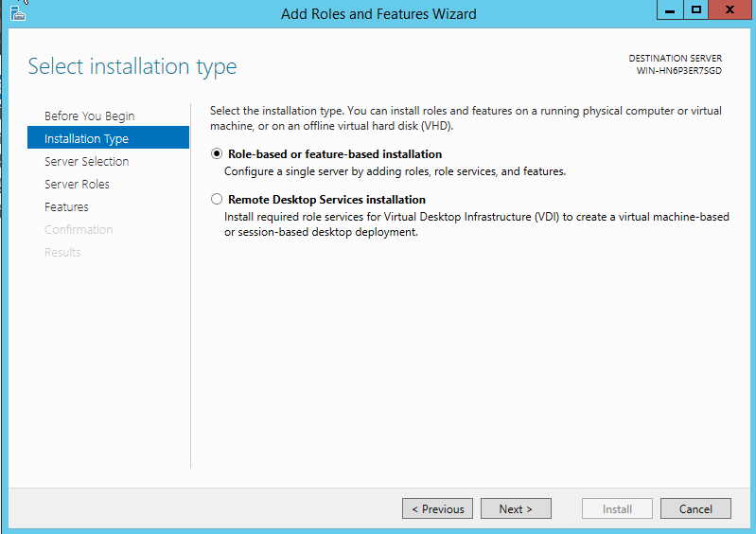
Step-3: Install ADDS Role

Slide 12
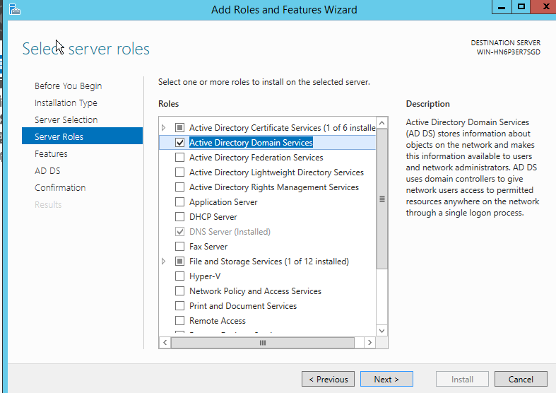
Step-3: Install ADDS Role

Slide 13
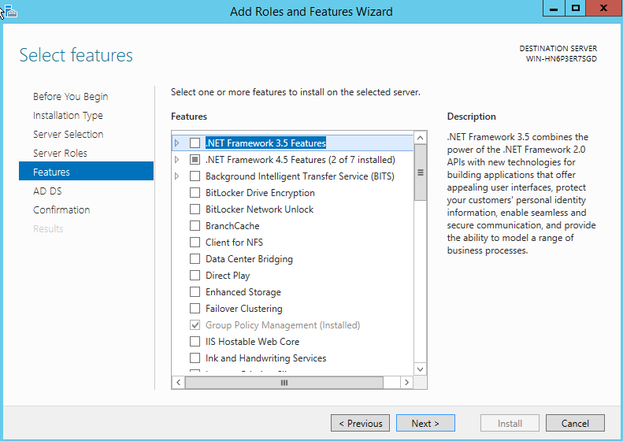
Step-3: Install ADDS Role

Slide 14
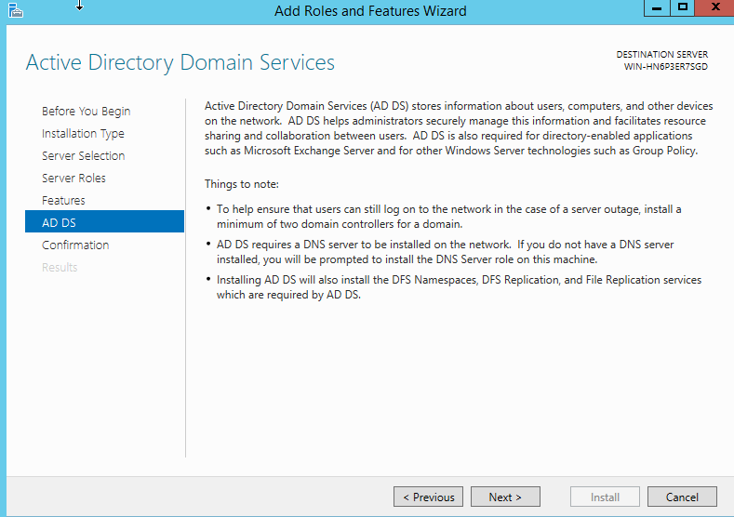
Step-3: Install ADDS Role

Slide 15
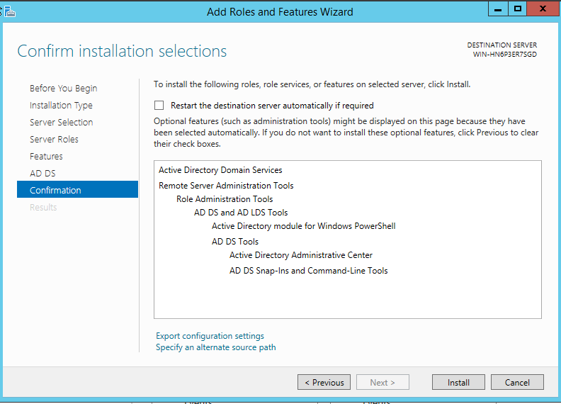
Step-3: Install ADDS Role

Slide 16
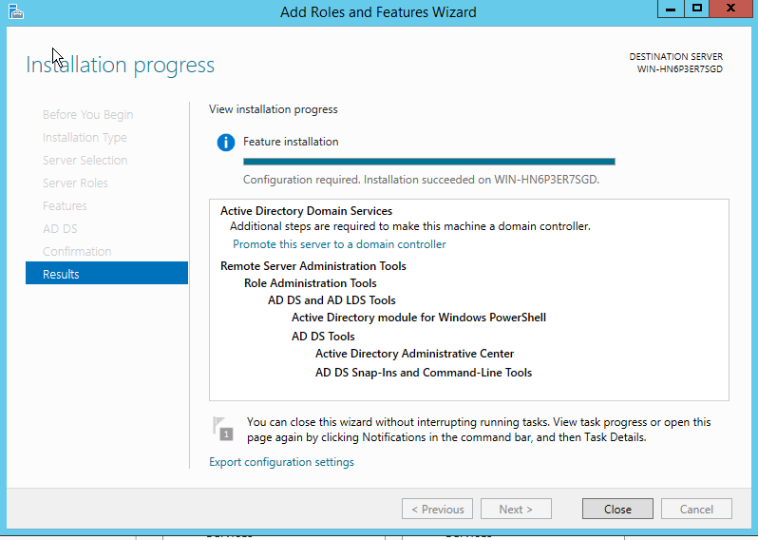
Step-3: Install ADDS Role

Slide 17
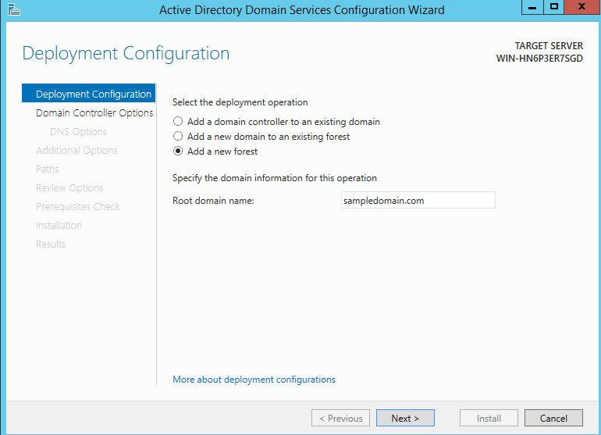
Step-3: Install ADDS Role

Slide 18
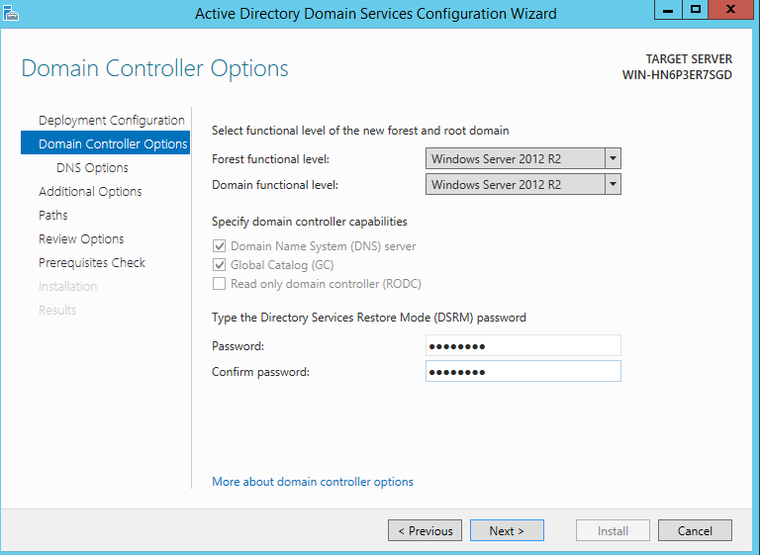
Step-3: Install ADDS Role

Slide 19
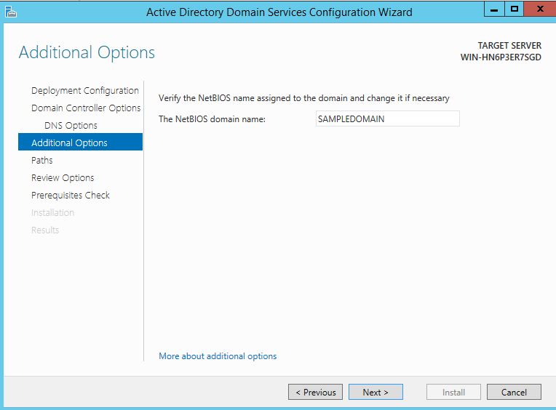
Step-3: Install ADDS Role

Slide 20
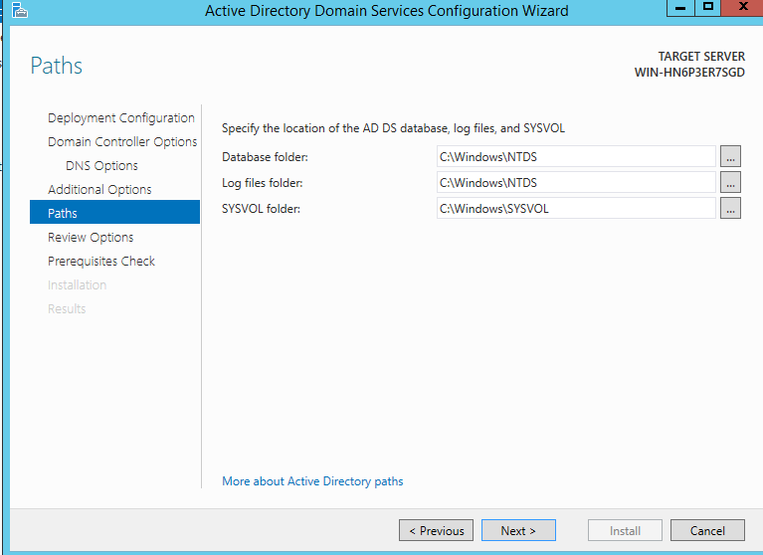
Step-3: Install ADDS Role

Slide 21
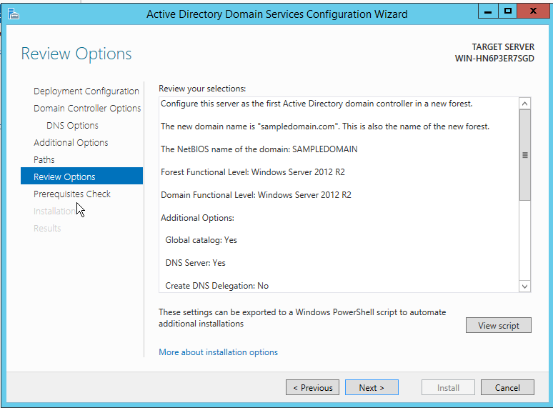
Step-3: Install ADDS Role

Slide 22
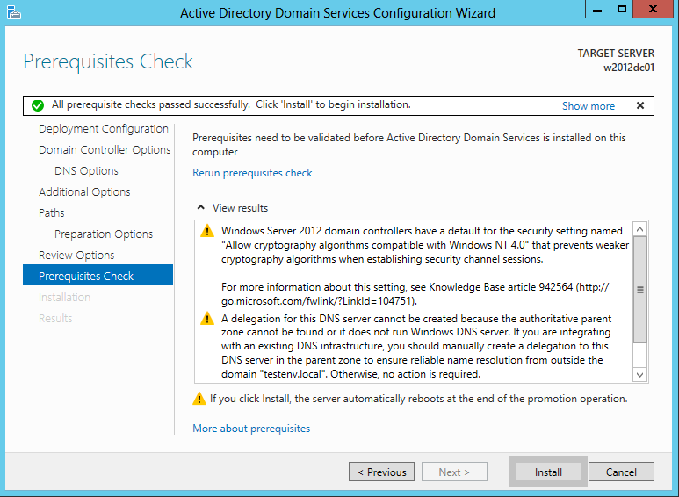
Step-3: Install ADDS Role

